Slide 1
7. PHP and MySQL
ICT – Training Technical Skills

Slide 2
PHP
Initially known as Personal Home Page
Now PHP stands for PHP: Hypertext Preprocessor
PHP is a widely-used, open source scripting language
PHP is free to download and use

Slide 3
What is a PHP File?
PHP files can contain text, HTML, JavaScript code, and PHP code
PHP code are executed on the server, and the result is returned to the browser as plain HTML
PHP files have a default file extension of ".php"

Slide 4
What Can PHP Do?
PHP can generate dynamic page content
PHP can create, open, read, write, and close files on the server
PHP can collect form data
PHP can send and receive cookies
PHP can add, delete, modify data in your database
PHP can restrict users to access some pages on your website
PHP can encrypt data

Slide 5
Why PHP?
PHP runs on different platforms (Windows, Linux, Unix, Mac OS X, etc.)
PHP is compatible with almost all servers used today (Apache, IIS, etc.)
PHP is free. Download it from the official PHP resource: www.php.net
PHP is easy to learn and runs efficiently on the server side

Slide 6
Basic PHP Syntax
A PHP script always starts with <?php and ends with ?>
We can also start a PHP script with <? and end with ?>.
<?php // PHP code goes here ?>

Slide 7
PHP example
<html> <body> <?php echo “Welcome to PHP programming!"; ?> </body> </html>

Slide 8
Comments in PHP
we use // to make a one-line comment, or /* and */ to make a comment block
<html> <body> <?php //This is a comment /* This is a comment block */ ?> </body> </html>

Slide 9
PHP Variables
Rules for PHP variable names:
Variables in PHP starts with a $ sign, followed by the name of the variable
The variable name must begin with a letter or the underscore character
A variable name can only contain alpha-numeric characters and underscores (A-z, 0-9, and _ )
A variable name should not contain spaces
Variable names are case sensitive (y and Y are two different variables)

Slide 10
Variables-Example
<?php $txt=“welcome to PHP programming!"; $x=16; ?>

Slide 11
The Concatenation Operator
The concatenation operator (.) is used to put two string values together
<?php $txt1="Hai World!"; $txt2="What a nice day!"; echo $txt1 . " " . $txt2; ?>

Slide 12
The strlen() function
<?php echo strlen("Hello world!"); ?>

Slide 13
The strpos() function
The strpos() function is used to search for a character/text within a string.
<?php echo strpos("Hello world!","world"); ?>

Slide 14
The if Statement
Syntax
if (condition) code to be executed if condition is true;
<html> <body> <?php $age=29; if ($d > 18){
echo “you are eligible to vote!";
} ?> </body> </html>

Slide 15
The if...else Statement
Syntax
if (condition) { code to be executed if condition is true; } else { code to be executed if condition is false; }

Slide 16
Example
<html> <body> <?php $age=29; if ($d > 18){
echo “you are eligible to vote!";
} else { echo “you are not eligible to vote!"; } ?> </body> </html>

Slide 17
The if...elseif....else Statement
if (condition) { code to be executed if condition is true; } elseif (condition) { code to be executed if condition is true; } else { code to be executed if condition is false; }

Slide 18
Example
<html> <body> <?php $age=4; if ($age > 18){
echo “you are eligible to vote!";
}
else if (age < 5) { echo “you are a small baby! you are not eligible to vote! "; } else { echo “you are not eligible to vote!"; } ?> </body> </html>

Slide 19
The PHP Switch Statement
Syntax
switch (n) { case label1: code to be executed if n=label1; break; case label2: code to be executed if n=label2; break; default: code to be executed if n is different from both label1 and label2; }

Slide 20
Example
<html> <body> <?php $x=1; switch ($x) { case 1: echo "Number 1"; break; case 2: echo "Number 2"; break; case 3: echo "Number 3"; break; default: echo "No number between 1 and 3"; } ?> </body> </html>

Slide 21
Array
An array is a special variable, which can store multiple values in one single variable.
There are two methods to create a array
(1) $cars=array("Saab","Volvo","BMW","Toyota");
(2) $cars[0]="Saab"; $cars[1]="Volvo"; $cars[2]="BMW"; $cars[3]="Toyota";

Slide 22
Example
<html>
<body>
<?php
$cars[0]="Saab";
$cars[1]="Volvo";
$cars[2]="BMW";
$cars[3]="Toyota";
echo $cars[0] . " and " . $cars[1] . " are list of costly cars.";
?>
</body>
</html>

Slide 23
The while Loop
Syntax
while (condition) { code to be executed; }

Slide 24
Example
<html> <body> <?php $i=1; while($i<=5) { echo "The number is " . $i . "<br>"; $i++; } ?> </body> </html>

Slide 25
The do...while Statement
Syntax
do { code to be executed; } while (condition);

Slide 26
Example
<html> <body> <?php $i=1; do { $i++; echo "The number is " . $i . "<br>"; } while ($i<=5); ?> </body> </html>

Slide 27
The for Loop
Syntax
for (init; condition; increment) { code to be executed; }

Slide 28
Example
<html> <body> <?php for ($i=1; $i<=5; $i++) { echo "The number is " . $i . "<br>"; } ?> </body> </html>

Slide 29
Create a PHP Function
Syntax
function functionName() { code to be executed; }

Slide 30
Example
<html> <body> <?php function writeName() { echo "Kai Jim Refsnes"; } echo "My name is "; writeName(); ?> </body> </html>

Slide 31
PHP Functions - Adding parameters
<html> <body> <?php function writeName($fname) { echo $fname . " Refsnes.<br>"; } echo "My name is "; writeName("Kai Jim"); echo "My sister's name is "; writeName("Hege"); echo "My brother's name is "; writeName("Stale"); ?> </body> </html>

Slide 32
My SQL
MySQL is a relational database management system
The database structure is organized into physical files optimized for speed.
The logical data model, with objects such as data tables, views, rows, and columns, offers a flexible programming environment.

Slide 33
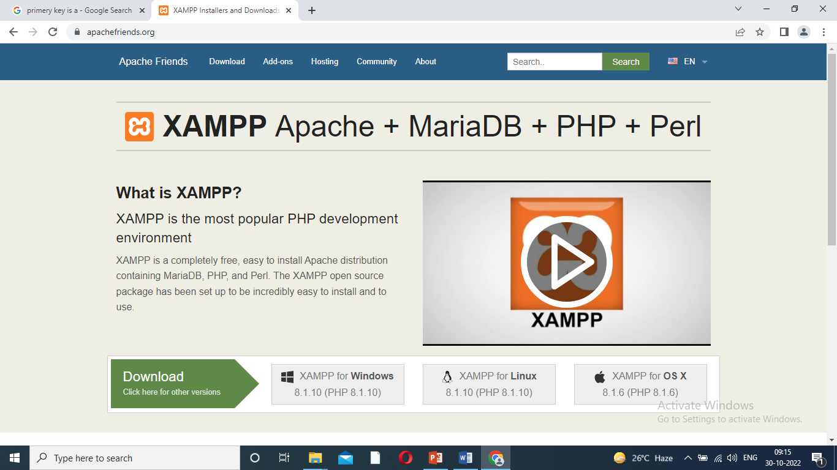
Installing XAMPP Server
Step 1:
Download XAMPP server -https://www.apachefriends.org/dowmload.html.
X-windows operating system.
A-Apache
M-MySQL
P-PHP
P-Perl

Slide 34
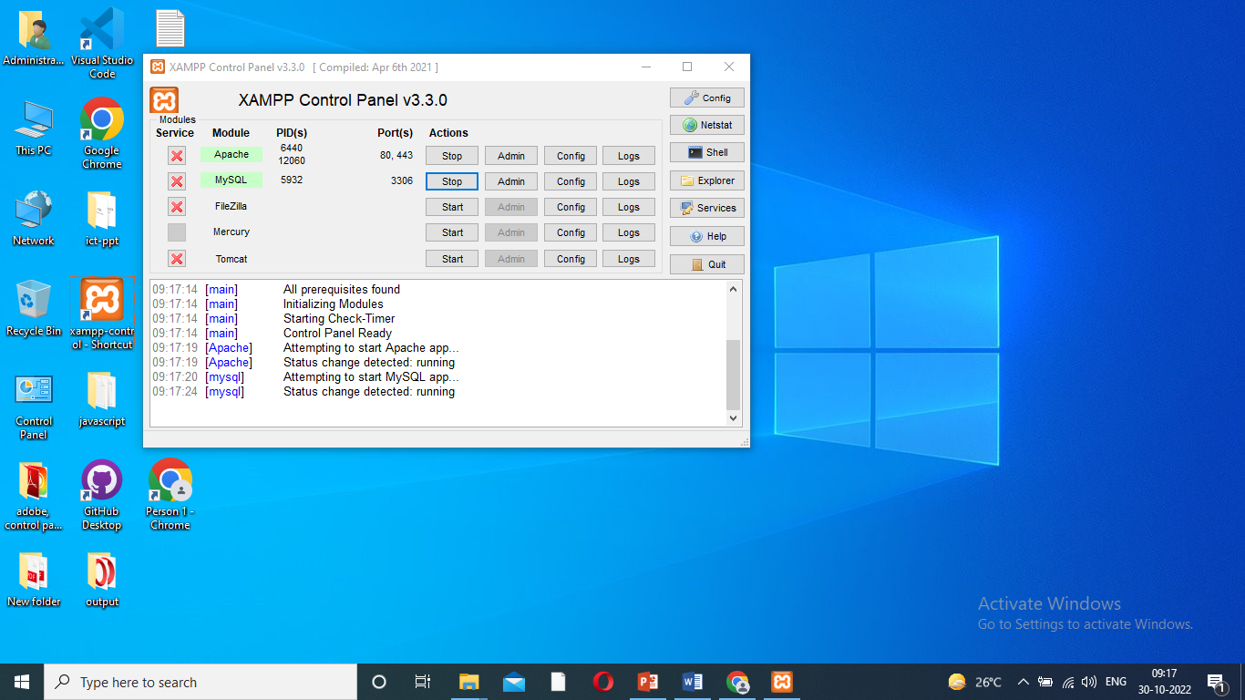
Continue..
Step 2:
Installed automatic server start.
C:\xampp-install-ok
C:\xampp=>xampp-control-short cut-desktop.

Slide 35
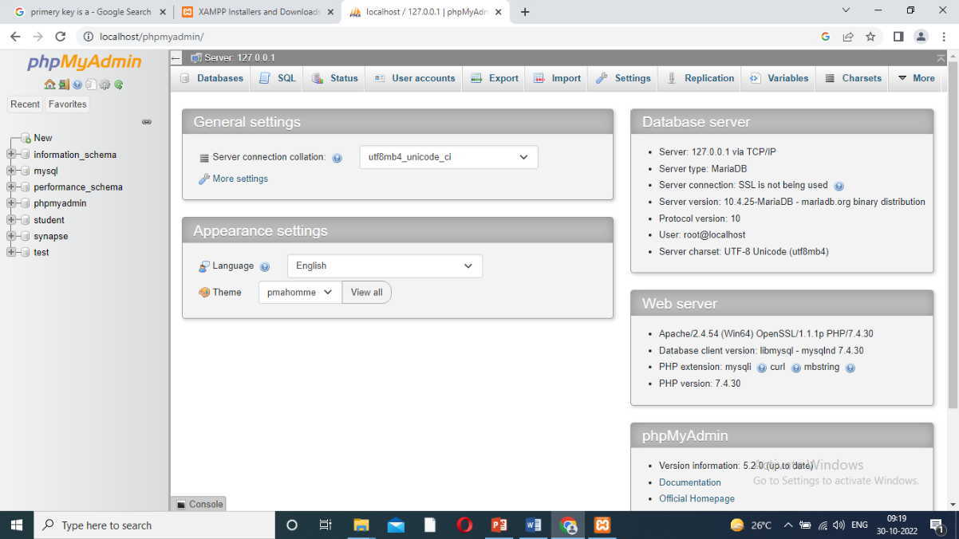
Continue..
Step 3:
Create database.
Google-type-localhost-click phpmyAdmin.

Slide 36
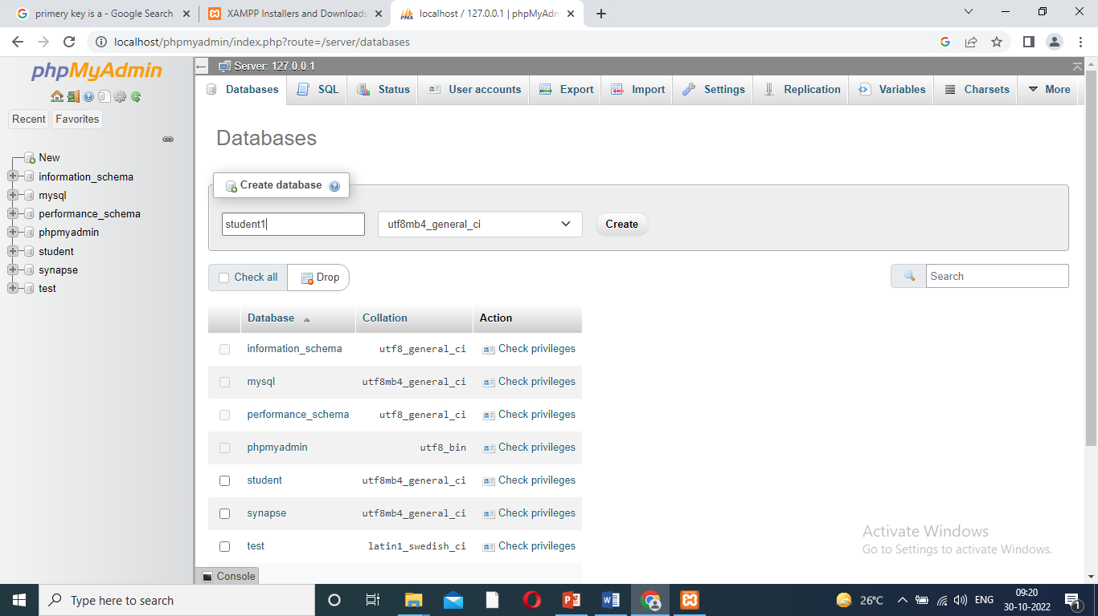
continue..
New – click – type name(i.e., student) –create database.
Database: Collection of records.

Slide 37
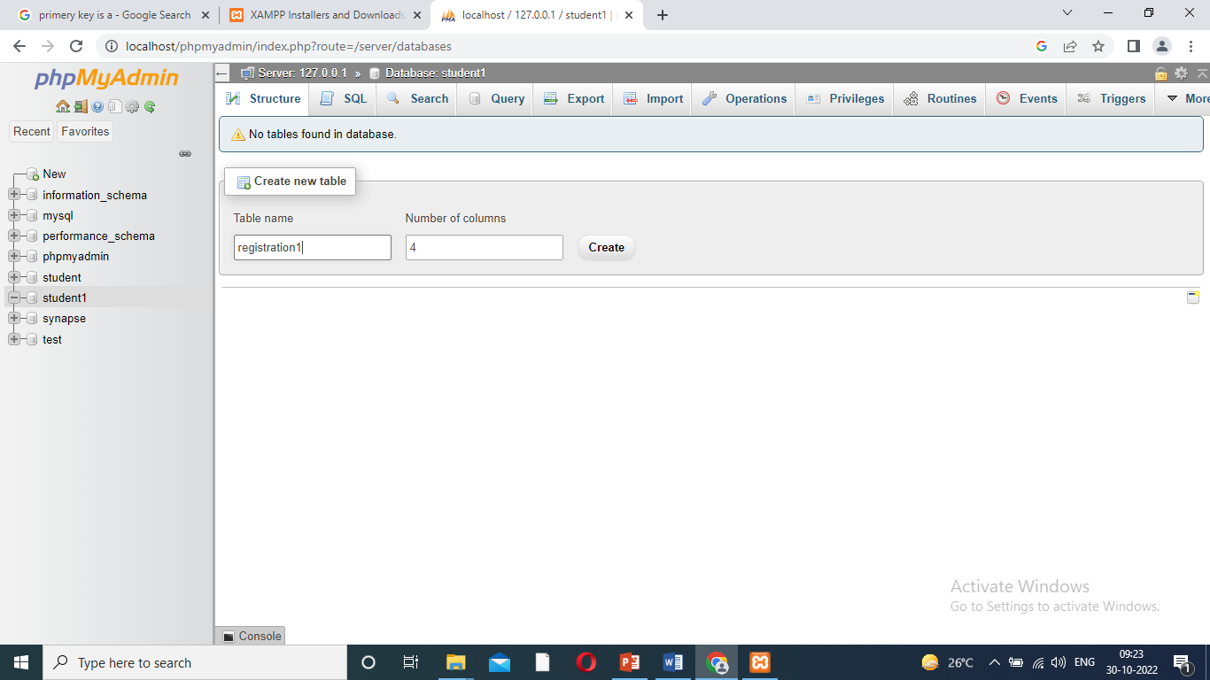
Continue..
Step 4:
Create new table
Table name (type registration)- then no. of coloums(type any number).
Now click create.

Slide 38
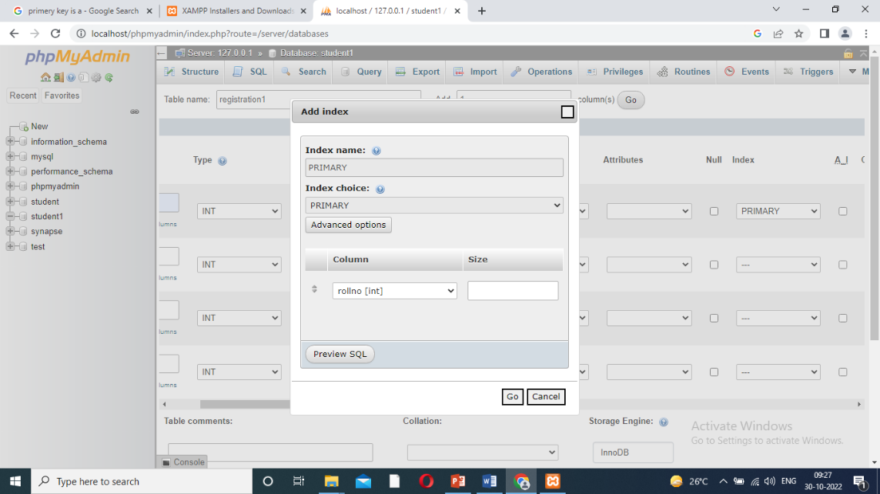
Continue..
Step 5:
Structure type the tables.
The type words select varchar- then length and values are any number selecting- index type to primary key-just go to save.
Example
Roll.no-1
Type-integer
Length-10
Index – primary

Slide 39
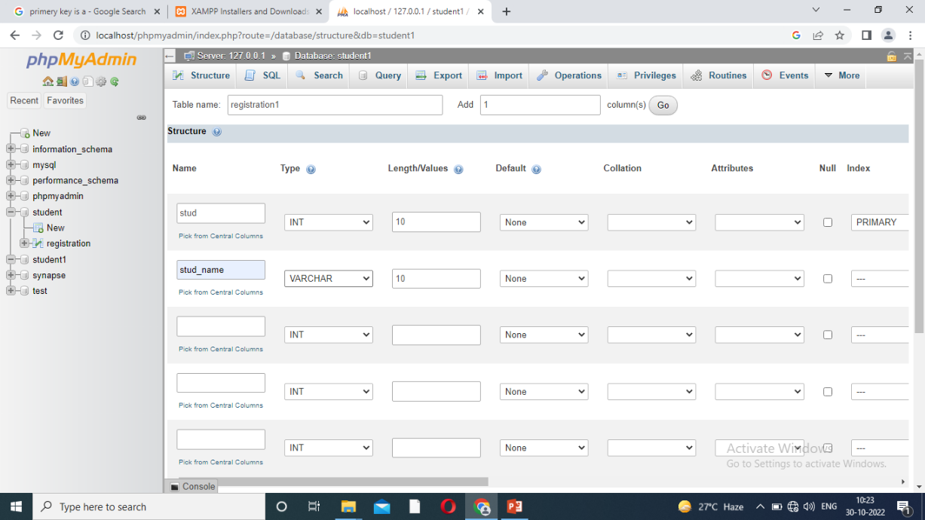
Continue..
Step 5:
Value added
Insert button also click- then type the values
Then click - registration.
Then next value to add same process.

Slide 40
Continue..
Step 6:
Insert option select
Type the values – table create- given to roll no, any other details- save.
Automatically created to given bellow command.
INSERT INTO `register` (`rollno`, `stud_name`, `stud_email`) VALUES ('101', 'Abi', 'abi@gamil.com');

Slide 41
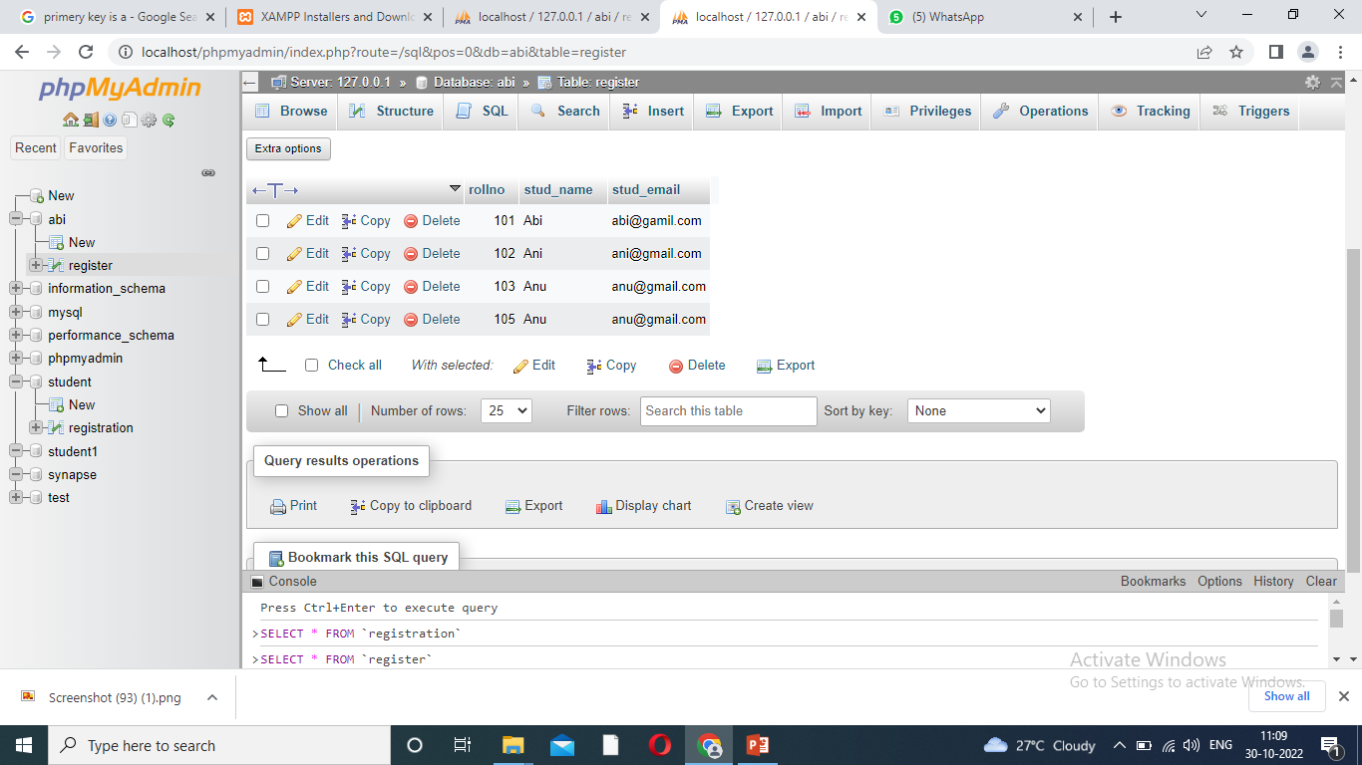
Insert the table values

Slide 42
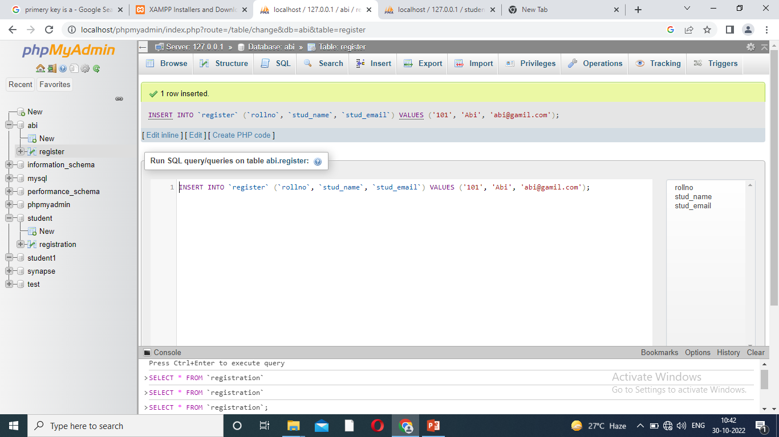
Automatically Create Command

Slide 43
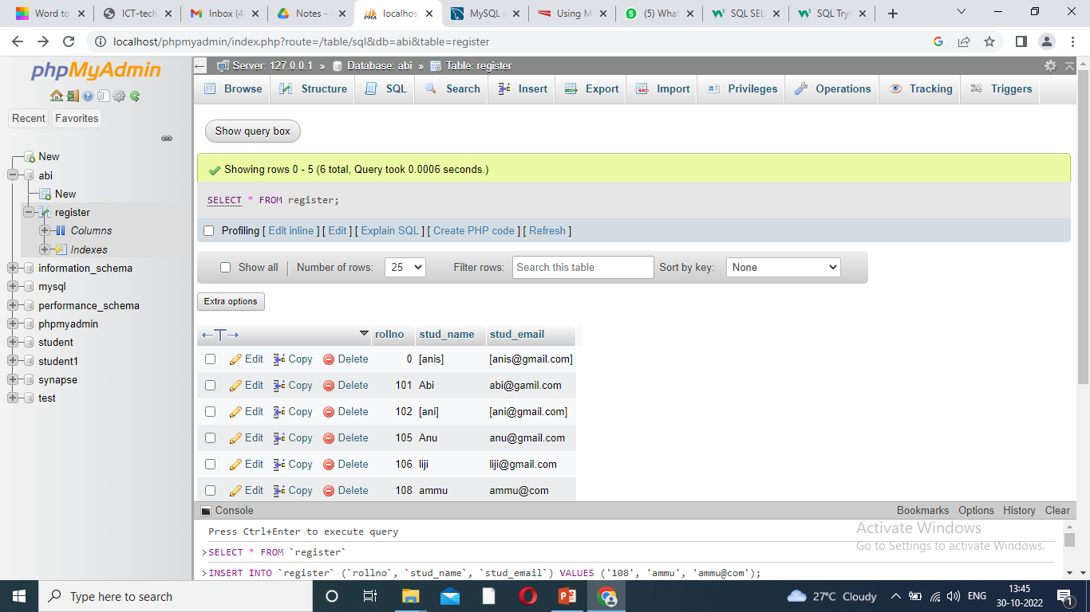
Select- option
Click to SQL - Click select- SELECT * FROM table name
- click go

Slide 44
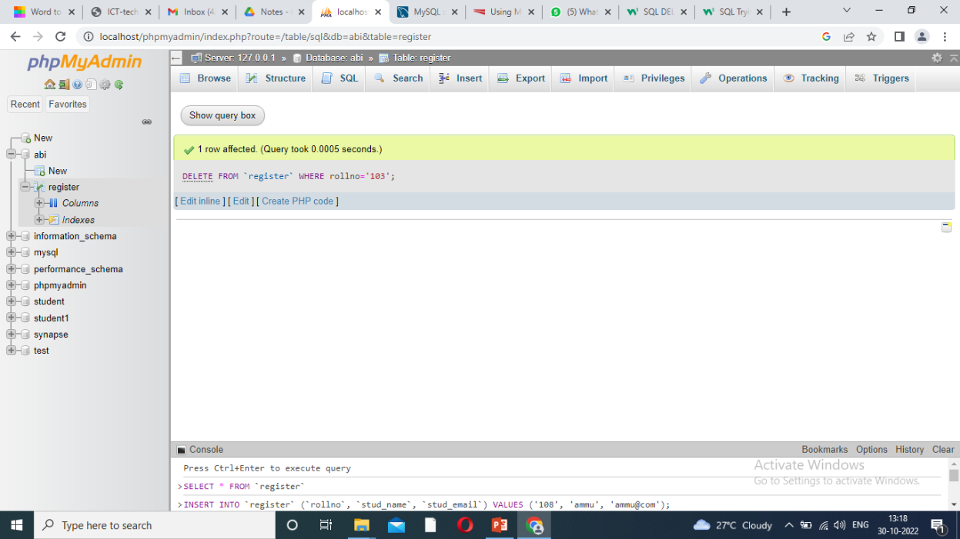
Delete Option
Delete- option:
Click to SQL - Click select- DELETE FROM table_name WHERE condition; - click go

Slide 45
Update- option
Click to SQL - Click select-
UPDATE table_name SET column1 = value1, column2 = value2, ... WHERE condition;
- click go

Slide 46
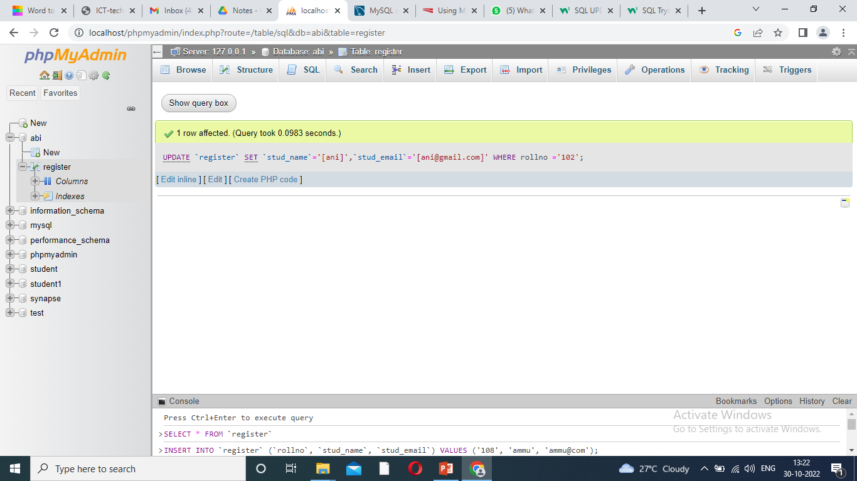
Update

Slide 47
Primary Key
A primary key is the column or columns that contain values that uniquely identify each row in a table.
A database table must have a primary key for Optim to insert, update, restore, or delete data from a database table.
Optim uses primary keys that are defined to the database.

Slide 48
Easy Way to Back End Connection
Already programmed – changes the simple way,
1. Database name: Select and copy Data base name in sql- paste the PHP programme- particular data base name.
2. Table name: Select and copy table name in sql- PHP programme paste to a particular table name.
3. Function values: Copy values in sql server- PHP programme paste to a particular table values.

